Slide 1
Project Proposal Presentation
By DE2 Rave
Jack Pearson
Harsh Chakhaiyar
Ravi Kodali
Charu Malhotra
Swetha Rajagopalan
1

Slide 2
Overview
Part I

Slide 3
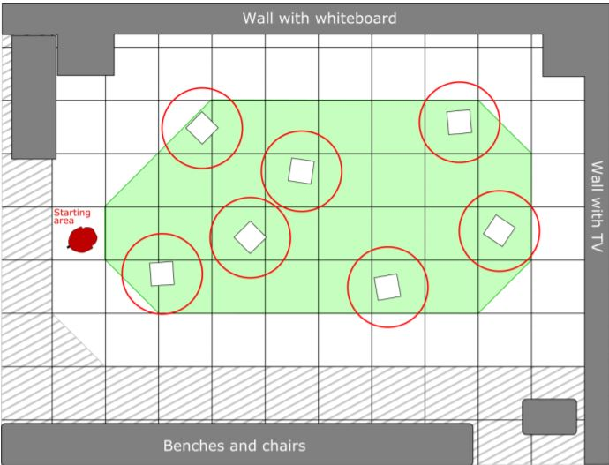
Project Description
Find and circle as many of the seven randomly placed reflectors as possible within two minutes.
A successful circle is when the bot intersects its own path to close a loop around a single reflector.
Causes for point deduction:
Collisions with reflectors
Collisions with walls or other objects
Create assembly code utilizing bot’s I/O devices to control movement.
Notes:
The project goal is to circle as many of the seven randomly placed reflectors as possible in two minutes. The reflectors will be placed in the demarcated area shown in green in the image here. In the best-case scenario, we hope to circle as many as 3 reflectors. Realistically, we guarantee that we will be able to circle at least one reflector since we have already been able to do that.
For a successful circling, the bot must maneuver around a single reflector and intersect its own path to close the loop. While the loop can be a closed shape other than a circle, we will take the approach of a nearly precise circle to achieve maximum time efficiency.
Causes for point deduction include colliding with reflectors, walls or other objects <point towards where these obstacles are>. We hope to avoid any collisions.
Our assembly code utilizes several I/O devices like driver motors, sonars, odometry, and the timer to control movement of the bot.

Slide 4
Overall Approach
Start by pointing the bot in the direction of the nearest reflector.
Use a repetitive algorithm consisting of two sub-routines.
1: Use sonars to detect a reflector, approach the reflector head-on and stop 18’’ away from it.
2: Use the bot’s odometry and timer to circle reflector.
Once a functional implementation is achieved, we will focus on optimizing the algorithm.
START
DETECTION/
APPROACH
CIRCLING
Notes:
Elaborate on each further
At the start of the demo, we will begin by pointing the bot in the direction of the nearest reflector.
The code to control movement consists of two sub-routines and the conditions used to turn and switch between sub-routines.
The first sub-routine uses sonars to detect a reflector, move towards the reflector and stop 18 inches away from it.
The second sub-routine uses the bot’s odometry to turn and the driver motors and timer to circle the reflector.
Once we have a functional implementation, we plan to continue optimizing our code to obtain a more robust result.

Slide 5
Technical Approach
Part II

Slide 6
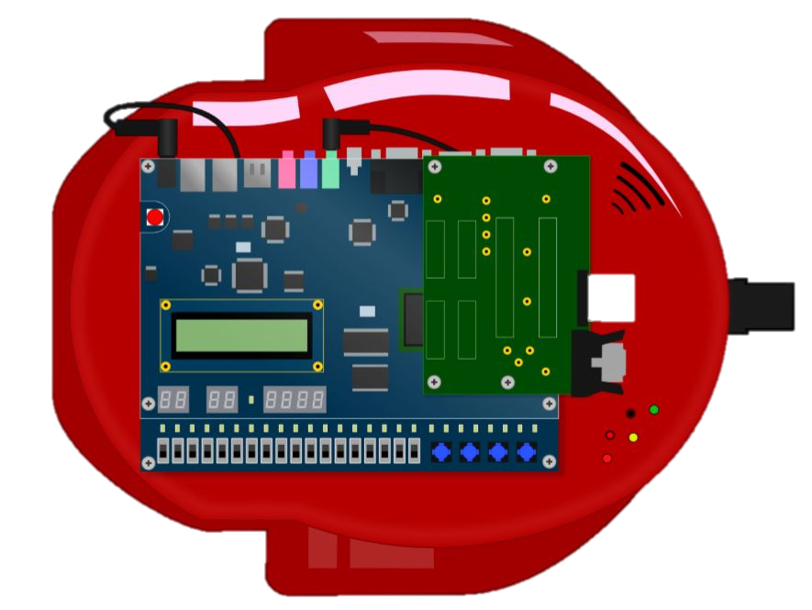
Approach to Begin Circling
Use sonars to stop 18’’ away from reflector.
At first, we implemented a 90° left turn to align the bot tangentially.
After experimentation, bot did not follow desired path.
Reflector
Desired result was achieved by decreasing the angle to 75°.
Notes:
To begin circling, we use the sonars to stop 18 inches away from the reflector.
At first, we used odometry to make a 90-degree left turn to align the bot tangentially to the desired circular path.
On running the code, we observed that this caused the bot to move in circle offset to the left from the desired path, bringing the bot dangerously close to the reflector on the right side.
Our first thought was to use sonars to try and correct the path if the bot moved came too close to the reflector. We soon found out that this was not a very effective solution because of the lag in sonar detection.
After tweaking the code several times, and repeated experimentation, we were able to direct the bot on the desired path by simply decreasing the turn angle to 75-degrees.

Slide 7
Approach to Circling
Use fixed ratio of speed of outer wheel to speed of inner wheel.
r
Set the outer radius to R= 24’’.
R
The inner radius is measured to be r = 14’’.
The ratio of circumferences is 24/14 = 1.714.
Reflector
Therefore, the ratio of speeds must also be 1.714.
Notes:
Our approach to circling the reflector is to use a fixed ratio of outer wheel to speed of inner wheel.
We set the outer radius to 24 inches.
By measuring the width of the bot, we determined the inner radius to be 14 inches.
By simple calculations we determined the ratio of circumferences and speeds to be 1.714.
This a lot more error proof and robust than using sonars or odometry.

Slide 8
Approach to End Circling
RESET TIMER/
START CIRCLING
Attempted using odometry to stop circling.
Found to have a large error, therefore unreliable.
CHECK TIME
Hypothesized using timer instead.
NO
Time period for one circle; T = Circumference/Avg Speed
T = 150.8 inches/ 19.69 inches/s
≈ 7.5 s
7.5 s?
YES
Found to work reliably after testing.
STOP CIRCLING
Notes:
We started by using odometry to stop once the heading of the bot has changed by 360-degree. We found that this approach resulted in a large error.
As an alternate approach, we tried using the timer to stop circling. The calculated time period for one circle was obtained as 7.5s.

Slide 9
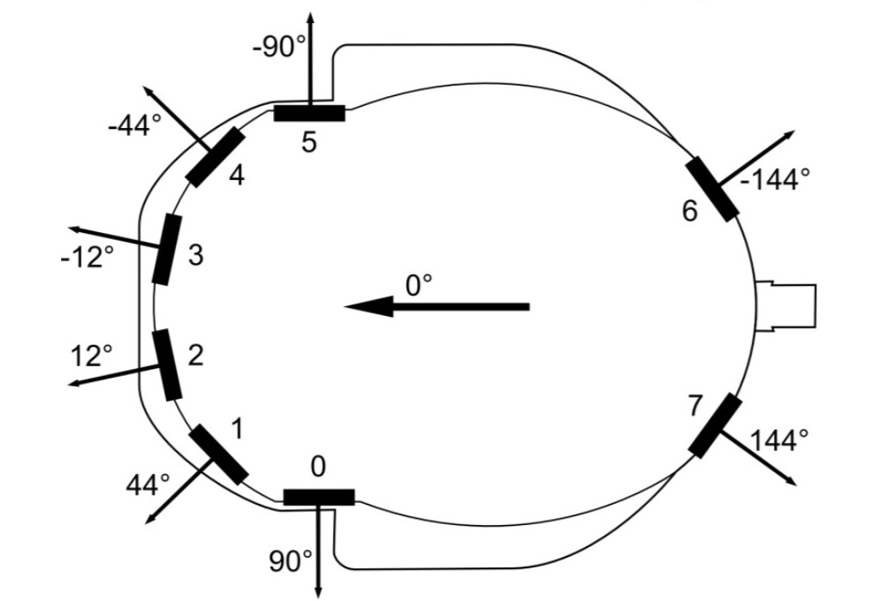
Approach to Alignment
Sonars 0-5 are deployed.
The readings are compared and the sonar that detected the minimum distance is selected.
Each sonar has a predetermined angle as shown in the adjoining figure.
Using odometry, the bot’s heading is adjusted so it faces the direction of the selected sensor.
Dtheta = Angle of chosen sensor
Notes:
We are using sonars to align the bot with its next target.
We deploy sonars one to five <point out the sonars in the image>.

Slide 10
Management Plan
Part III

Slide 11

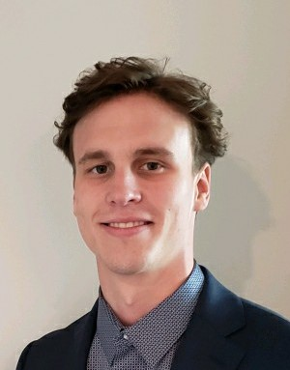
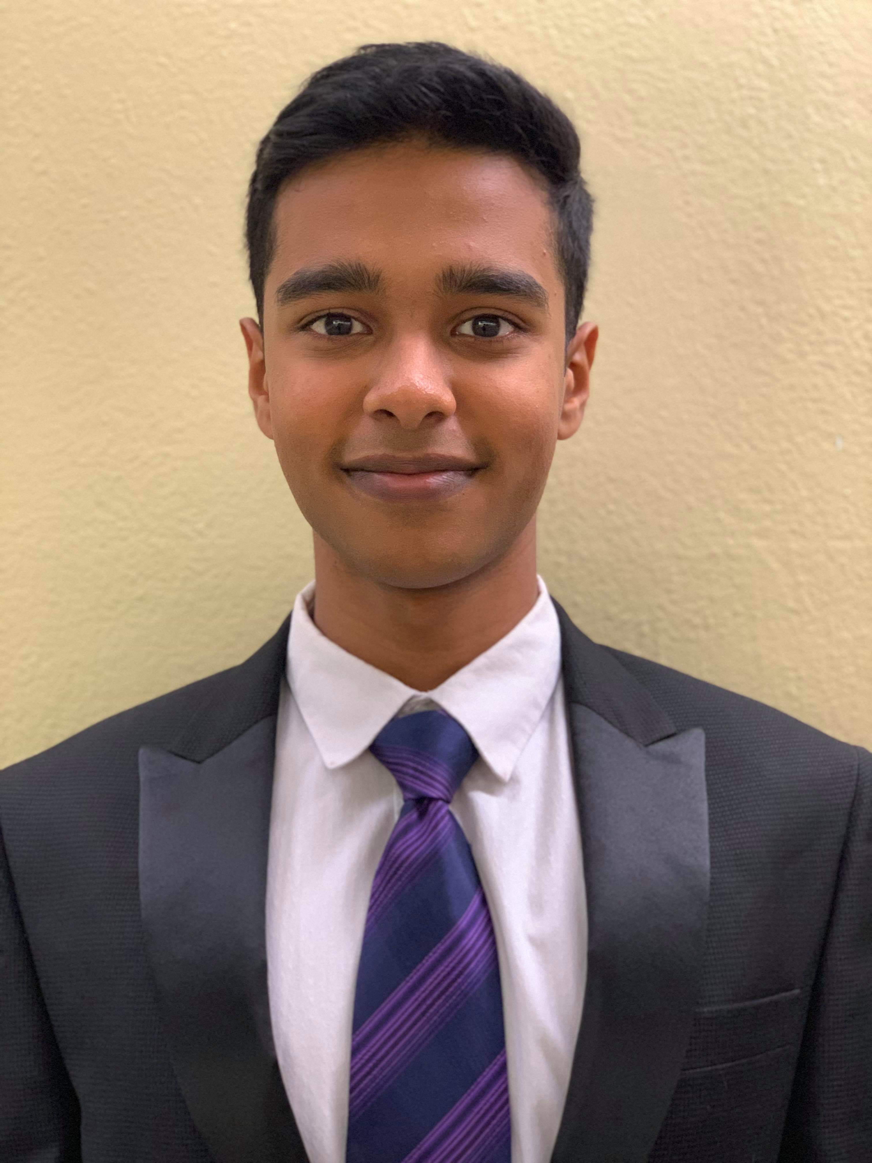

DE2 RAVE
MEET OUR TEAM
Meet deadlines for deliverable documents
In-charge of proposal presentation
In-charge of design summary
Documentation, i.e maintain google drive, etc.
Establish project schedule
Monitor progress to ensure conformance with project plan
Set deadlines
Lead meetings
Maintain meeting notes and Consensus Forms
Establishing the scope of the project
Set achievable goals geared towards ultimate project goal
Developing core framework of the code
Expert in assembly programming and DE2 bot function
Work with DM to ensure feasibility of project vision
In-charge of final bot code
Develop unit tests
Debug and run tests
Anticipate challenges with code
Write code to handle edge cases
Work on alternate approaches to maintain timeline
…..
Charu Malhotra
Jack Pearson
Harsh Chakhaiyar
Ravi Kodali
Swetha Rajagopalan
Creative Manager
Project Manager
Design Manager
Technical Expert
Risk Manager
11
Notes:
Project Manager: Establishing a project schedule and planning each phase. Setting deadlines for specific performance milestones. Monitoring project progress to ensure conformance to the project plan and updating the plan as necessary. Leading team meetings according to preset agenda. Maintaining meeting notes and preparing Consensus Forms at the end of each meeting.
Engineering Design Manager: Establishing the scope of project design.
Technical Expert: Using expertise in assembly programming and DE2 bot function to ensure that the technical design aspects of the project are well defined and correctly implemented. Conducting repeated experimentation to ensure proper function and meet quality assurance standards.
accountable for administrative, financial, and risk management operations

Slide 12
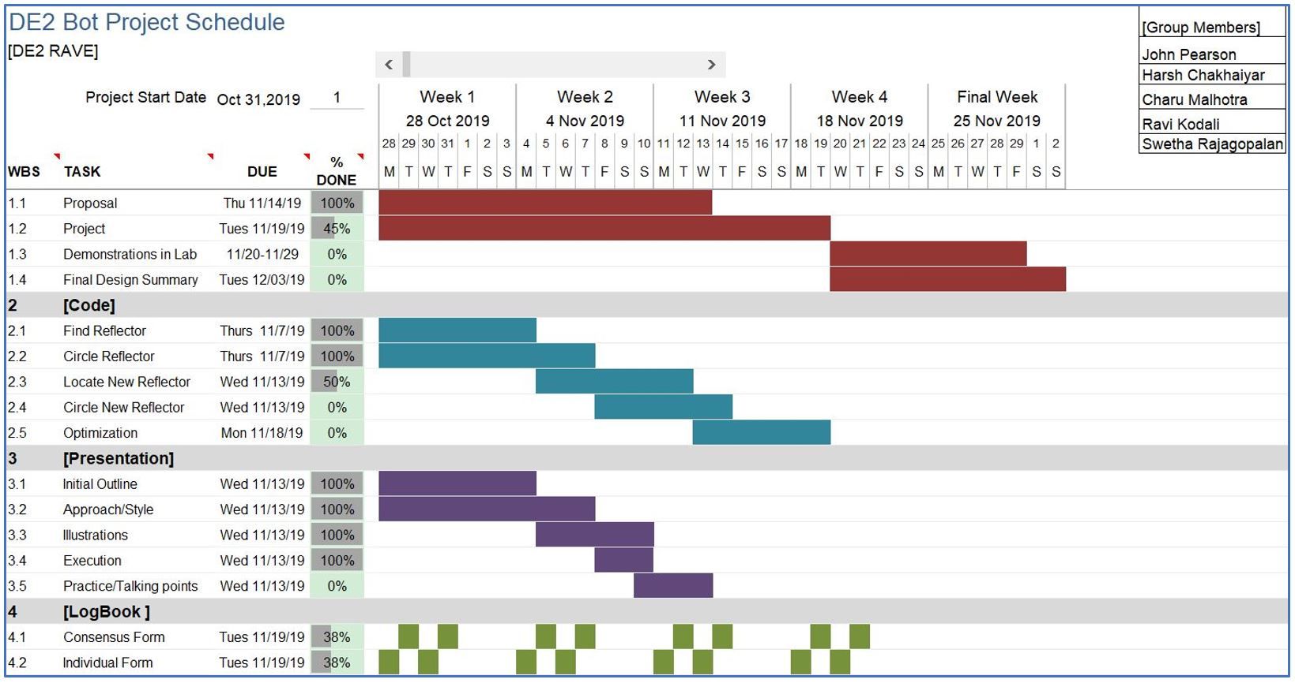
12

Slide 13
Summary and Questions
Part IV

Slide 14
Summary
Our algorithm for this project includes two main sub-routines, approaching a reflector and circling a reflector.
It also includes the conditions to turn and change sub-routines.
We have been able to circle first reflector and are currently working on locating the second reflector.
We feel confident about keeping up with our time-line. For the final demo, we
Will certainly circle one reflector
Have confidence that we can circle 2
Hope we will be able to circle 3 reflectors
14

Slide 15
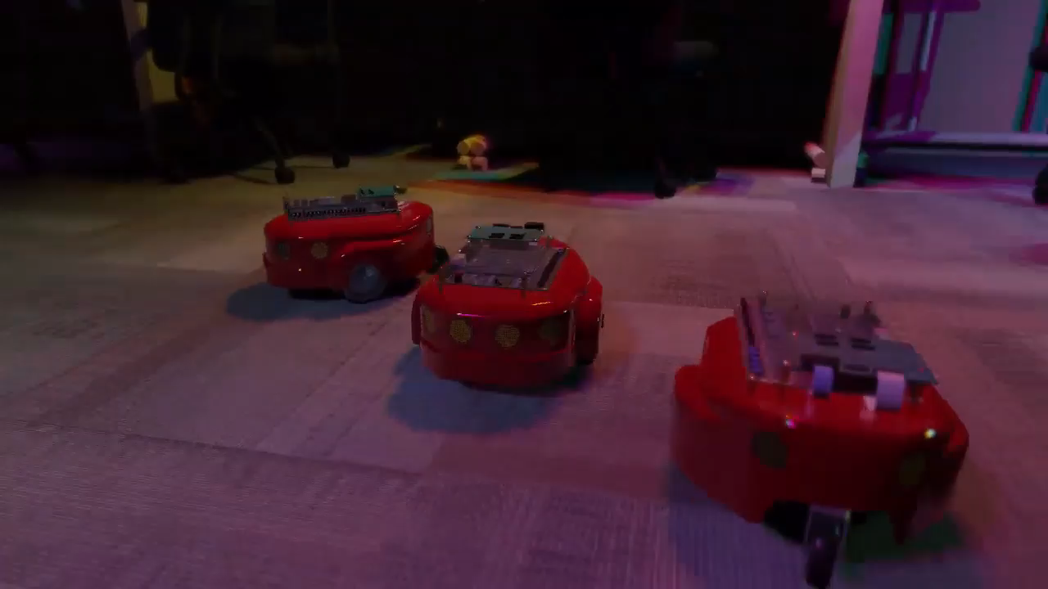
LET’S RAVE!
Video credit: knflrpn

